Slide 1


UKIEPC 2015
Post-Contest Presentation rgl@google.com

Slide 2
Some words
First, apologies for the judge lag in the first two hours.
UKIEPC has previously been hosted alongside the NCPC, a larger contest. Most of the people working on this event had no experience with hosting any kind of programming contest until a few months ago.
This was a painful lesson, but somewhat necessary to go through to ensure it doesn’t happen again in the bigger contests we plan to hold in future.
Thanks to Rob Perkins and Jaap Eldering for rescuing the servers.

Slide 3
Some numbers
2012: 0 teams 2013: 52 teams; 5 sites 2014: 61 teams; 9 sites 2015: 142 teams; 12 sites
First correct submission: 00:18:32 – C, DoCThors (Imperial College London) Last correct submission: 05:14:56 – G, Ariel (Trinity College Dublin) Number of submissions: 959
742 lines of code to solve the whole set.

Slide 4
Some names
Organisers: Max Wilson, James Davenport, Christian Ledig
Writers: Sander Alewijnse, Jaap Eldering, Swen Gaudl, Jim Grimmett
Reviewers: Rowan Lee, Nicolas Prevot, James Stanley
SysAdmins: Jaap Eldering, Rob Perkins
Illustrator: Lisa Abose

Slide 5
Problem Solutions

Slide 6
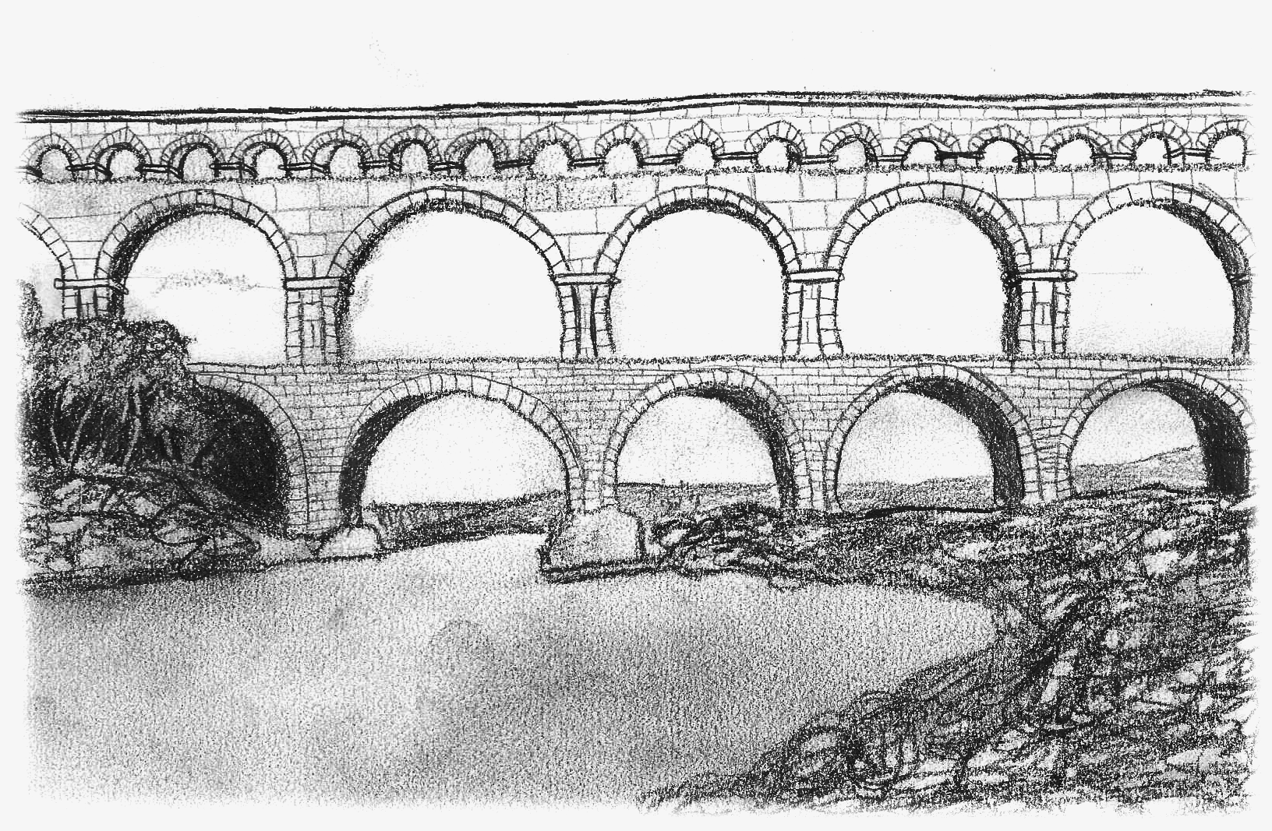
A - Aqueducts
Overview
Given a graph which is:
weighted (by distances)
directed (downhill)
acyclic
And has:
up to 40 source points, S
up to 40 sink points, T
Find a way to pair up elements from S and T so that:
every item from T has an item from S.
there is a downhill route between each S and T pair.
Minimise the cost of this matching.
2 correct • solved at: 04:26 by
EE Dragons (University of Cambridge)
Author: Jim

Slide 7
Aqueducts - Solution
Techniques
Algorithm
Dijkstra’s algorithm
Breadth-first search
Minimum cost flow
We are only interested in hills from S and T.
Make a new graph of vertices from {S,T} where edge cost is their distance in the original graph (according to Dijkstra's algorithm)
This will be a bipartite graph.
Look for a minimum-cost matching.
Hungarian algorithm (classical weighted matching method)
O(S³) on 40 vertices is very fast.
Overall complexity will be O(S³+S⋅N²⋅logN)
Minimum cost maximum flow
Can work directly on the original graph, as long as it’s well-optimised.
O(S⋅N²⋅logN)

Slide 8
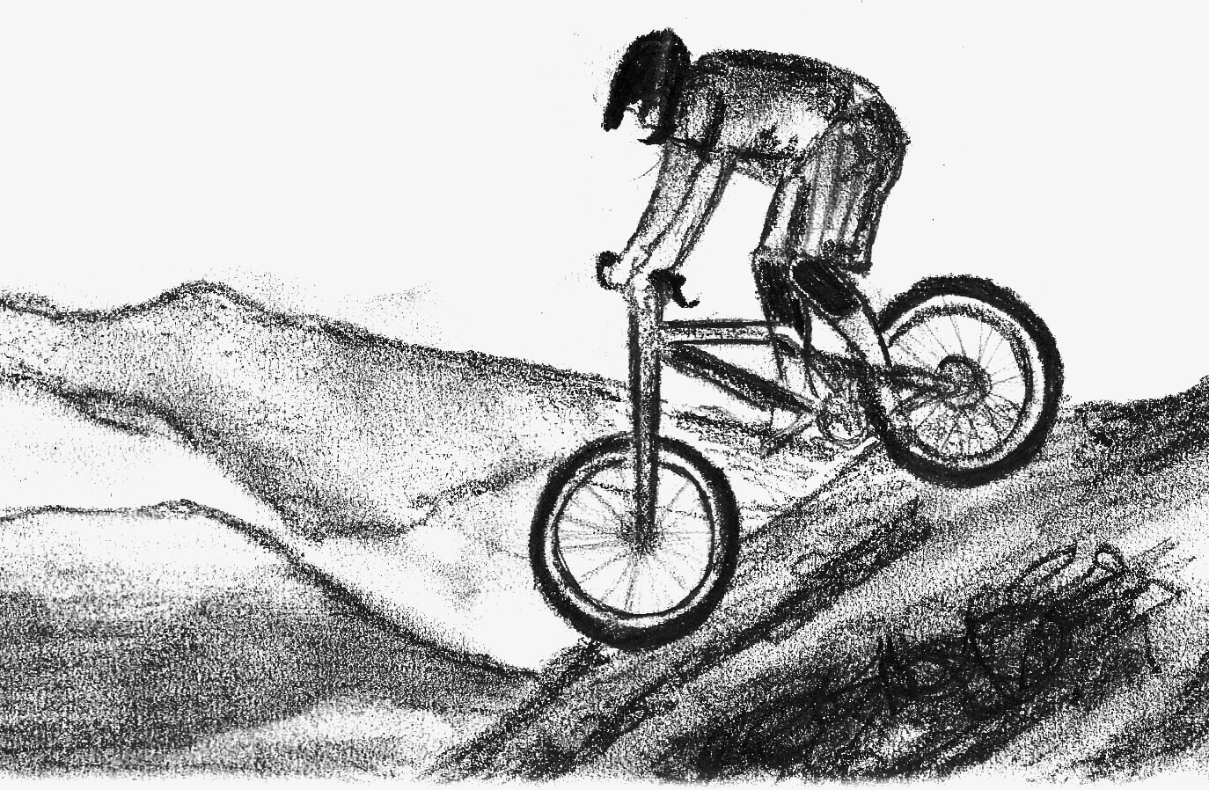
B - Biking
Overview
We have a series of up to 4 sections of a hill, with various inclines and sloped distances.
Each section starts from where the last left off.
Given a formula for acceleration, find the final speed of a bike if it starts at the top of any of the segments.
75 correct • solved at: 00:28 by
Boole’s Fools (University of Cambridge)
Author: Robin

Slide 9
Mountain Biking - Solution
Techniques
Algorithm
Trigonometry
Mechanics
Say we start off at speed v₀ and finish at speed v_{d} (after D metres).
Integrate the formula for acceleration:
v_{d} = v₀ + gt×cos(θ)
d = v₀t + ½gt²×cos(θ) ... + C
Solve for t:
½gt²×cos(θ) + v₀t - d = 0
t = (-v₀±√(v₀²+2gd×cos(θ))) / (g×cos(θ))
Substitute back in, iterate over line segments
Or:
Potential energy E_{p} = mgh
Kinetic energy E_{k} = ½mv²
v∞ = sqrt(2×g×h)

Slide 10

C - Conversation
Overview
Given a set of specifications like:
key1 value₁ value₂ value₃
key2 value₄ value₅ value₆
Find the values that belong to every single key.
Among these values, sort them:
By frequency descending.
Break ties lexicographically.
58 correct • solved at: 00:18 by
DoCThors (Imperial College London)
Author: Jim

Slide 11
Conversation Log - Solution
Techniques
Algorithm
String chopping
Hash maps
Sort by key
Schwartzian transform
We need two pieces of information about each word:
Which users it was associated with (for filtering)
How many times it appeared (for sorting)
Map each username to an integer
Every time we encounter a new word, initialise a structure: struct Word { string text; int freq = 0; set<UserId> users; bool operator < (Word const &other) const { return freq != other.freq ? freq > other.freq : text < other.text; } }
Update each word on a line by adding the userId to its set
Filter for users.count() == MAX_USER_ID, sort, and print!

Slide 12
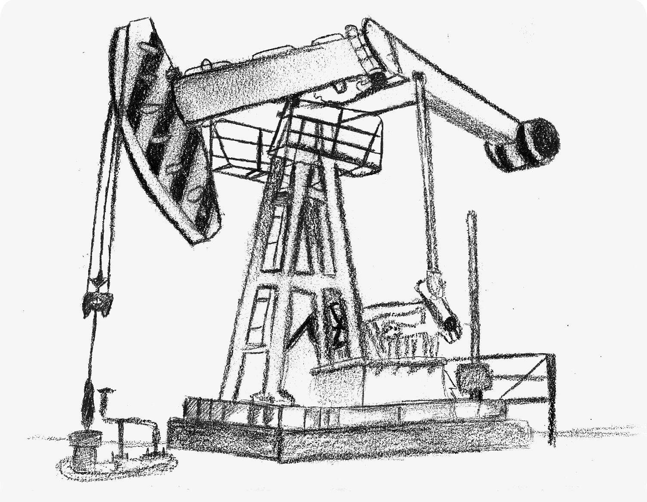
D - Drilling
Overview
Given a 3D surface
As a set of polygon-shaped contour lines
Compute the point p
On the surface
With shortest distance to origin
3 correct • solved at: 02:41 by
DoCThors (Imperial College London)
Author: Robin

Slide 13
Slant Drilling - Solution
Techniques
Algorithm
Geometry
Point-in-polygon
It’s always best to drill either straight down, or from the lower edge of a contour.
Find the closest point to the origin on each contour segment, and calculate sloped distance.
Iterate over every segment
Create a cost function C = (ax+(bx-ax) × i)² + (ay+(by-ay) × i)²
Differentiate and solve for d(C)/d(i) = 0
Find which contour contains the origin
Cast a ray in some arbitrary direction. If and only if the origin is inside a contour the ray will cross that contour an odd number of times.
Take the candidate contour with the smallest area.

Slide 14
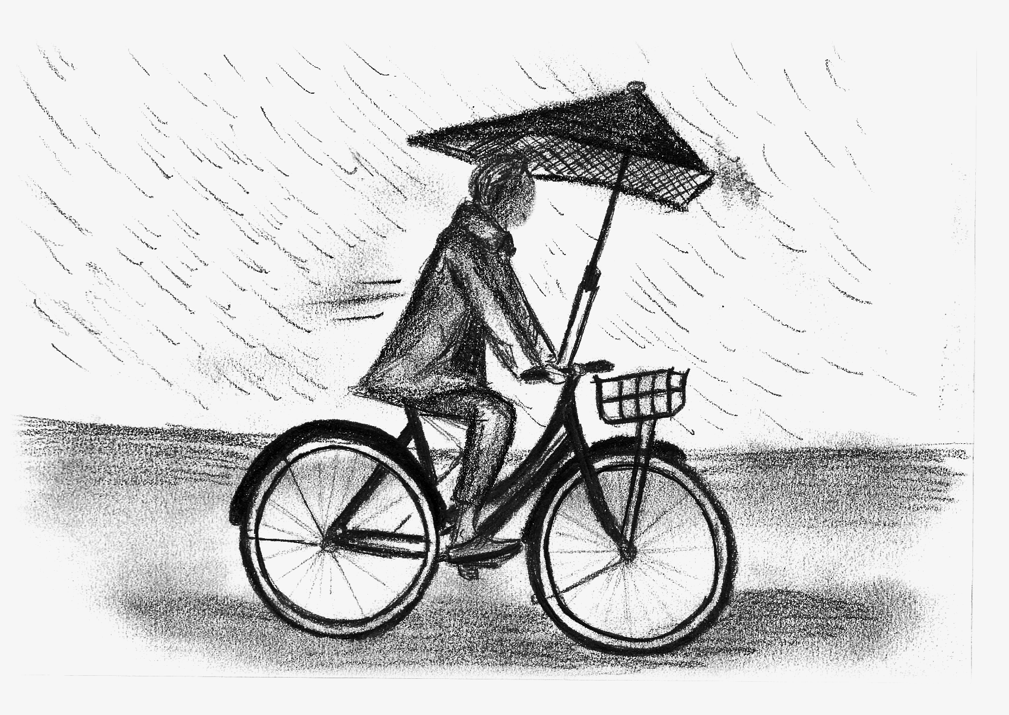
E - Rainfall
Overview
Balance two cost functions for the same situation:
The rate of sweating, proportional to speed²
The amount of rain across the journey, a function of start time and speed, decreasing as speed increases
Choose a start time and speed to minimise the total cost.
1 correct • solved at: 04:40 by
EE Dragons (University of Cambridge)
Author: Jaap

Slide 15
Rainfall - Solution
Techniques
Algorithm
Calculus
Cumulative sums
Ternary search
Dynamic programming
Algebra shows it’s always best to keep a constant speed
Try every possible starting and ending minute
O(N) × O(N) = O(N²)
If we are going to chop off some fractional time x to decrease rain (at the expense of cycling faster), we’ll chop off part of the rainier of the start and end minutes.
Reducing time by more than 1 falls within another [start, end] pair so we can ignore that case.
cost = sum(rain[S:T]) - x × rain[edge] + constant/(T-S-x)
Differentiate cost and solve for dCost/dX = 0
0 ≤ x ≤ 1
Don’t forget x = 0 and x=1

Slide 16
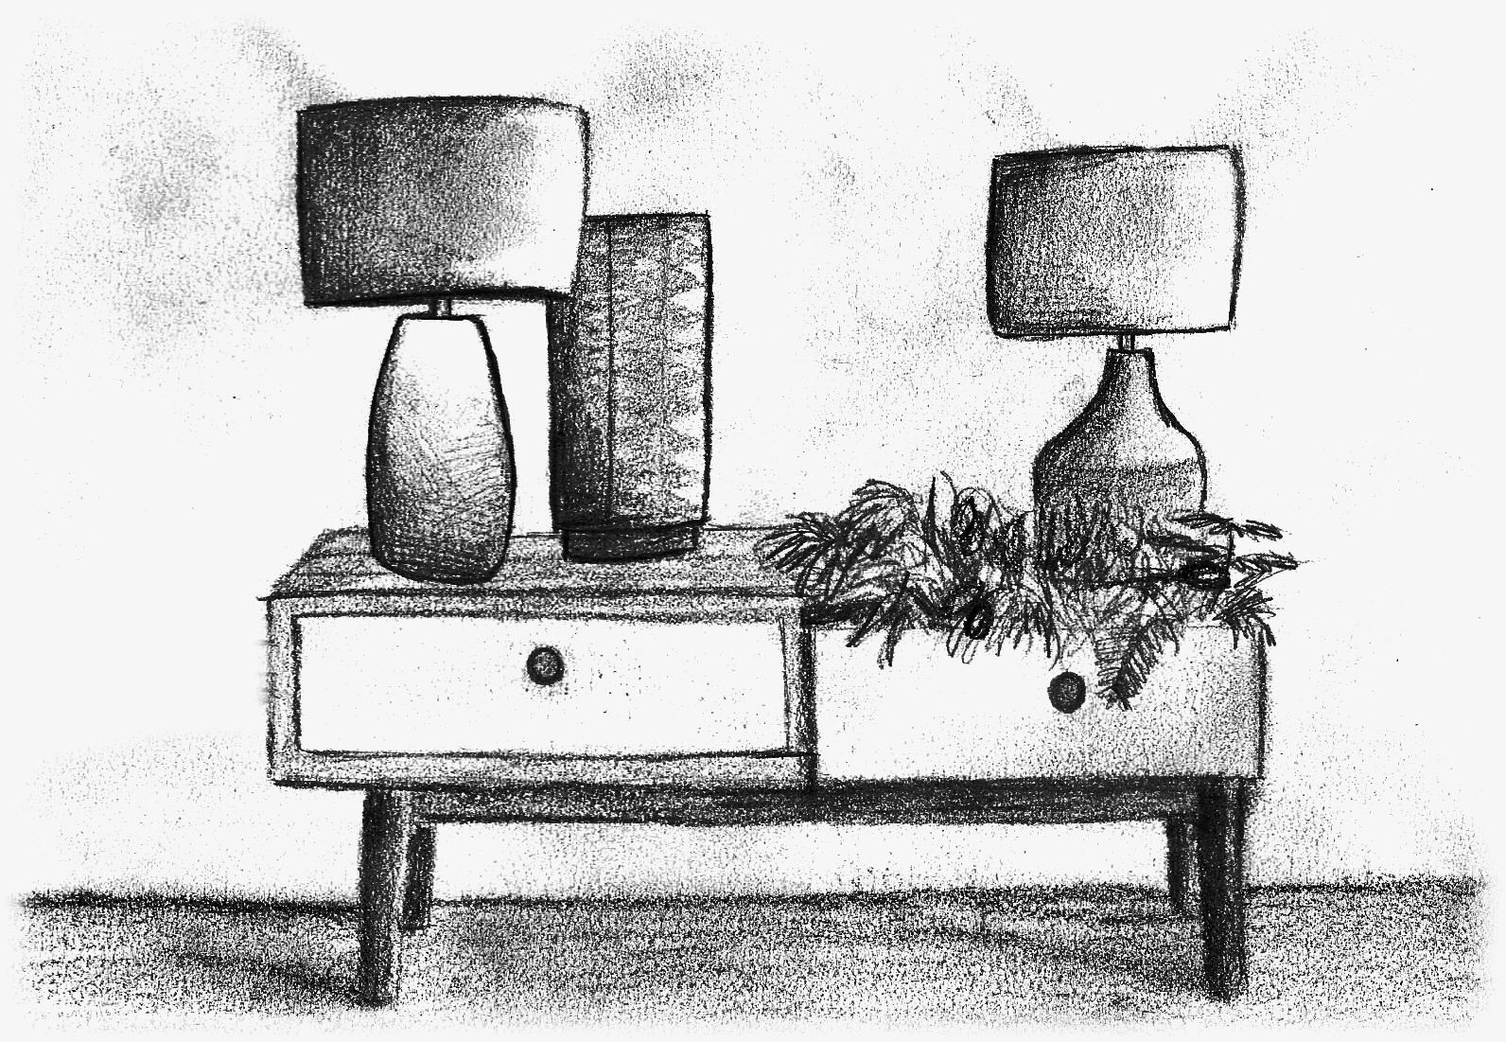
F - Physiognomy
Overview
Given up to 12 weighted squares of equal size,
Make a loop around some subset of them such that:
The loop is continuous.
The sum of weights inside the loop is equal to the sum of weights outside.
Make this loop as short as possible.
0 correct
Author: Robin

Slide 17
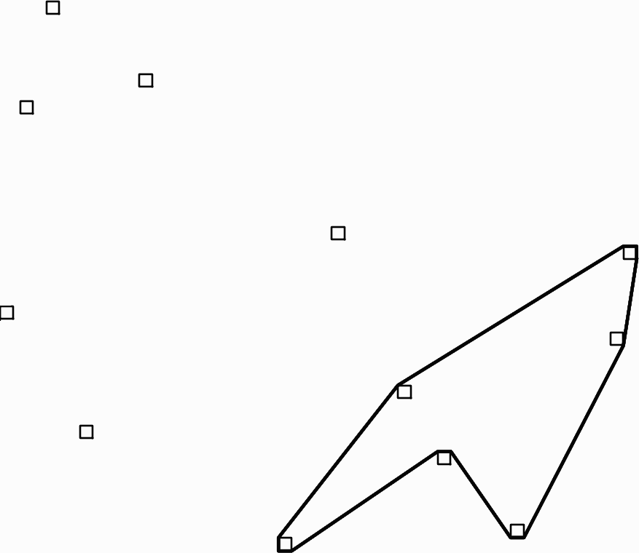
Physiognomy - Solution
Techniques
Algorithm
Topology
Point-in-polygon
Bitmasks
Travelling salesman
Dynamic programming
Assume we already constructed the loop
In this case, we can find whether a lamp is inside by the same means as drilling: if and only if it’s inside, the number of loop segments crossed in any direction will be odd.
Let’s make that part of our state:
minimum_loop[start][pos][n₁,n₂,...,n₇,n₈]... n^{n} possibilities?
We only need to know the parity, not the exact number.
minimum_loop[start][pos][2^{n}]
How many possibilities for start and pos?
A minimal loop always touches only corner vertices, of which there are at most n × 4 = 48.
Time complexity: O(n³ × 2^{n})

Slide 18
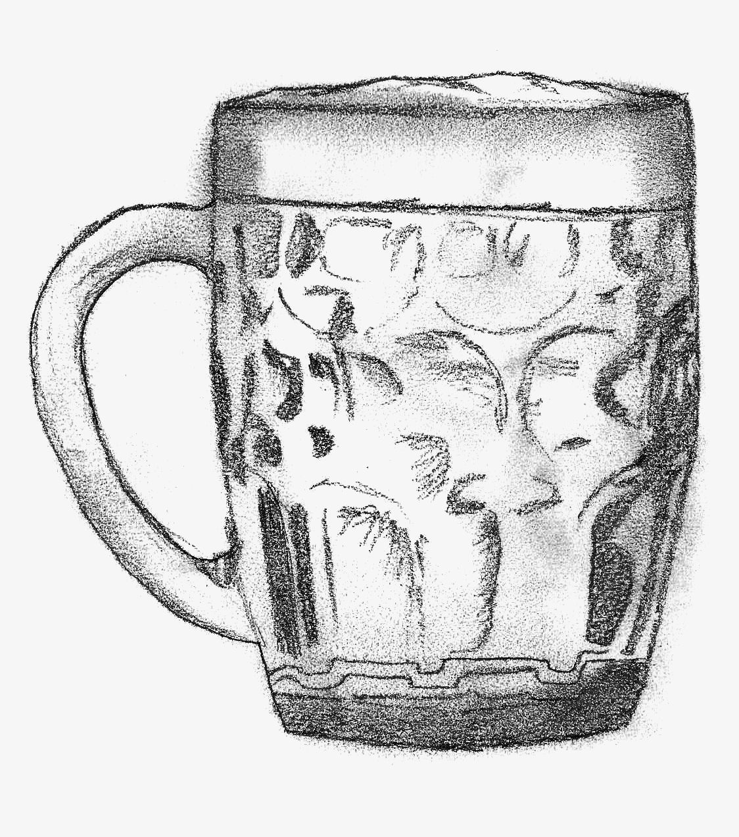
G - Drinking
Overview
We have a collection of beers
Various costs
Various alcohol contents
Various sizes of glass
We have targets:
Spend a certain amount of money
Drink a certain amount of alcohol
We need to find a way of meeting these targets exactly by choosing a list of orders
Some can be chosen several times
Some can be ignored
18 correct • solved at: 01:53 by
Y U NO ACK (Imperial College London)
Author: Jim

Slide 19
Drink Responsibly - Solution
Techniques
Algorithm
Fixed-point arithmetic
Knapsack problem
Depth-first search
Memoisation
Imagine a straightforward depth-first search:
def solve(i, units_left, money_left): if units_left <= 0 or money_left <= 0 or i >= n: return [] if (units_left | money_left) == 0 else None sol_with = solve(i, units_left-units[i], money_left-price[i]) sol_without = solve(i+1, units_left, money_left) if sol_with is not None: return [beer] + sol_with elsif sol_without is not None: return sol_without else: return None
Q: How many possible sets of parameters can this take?
A: O(N) × O(U) × O(M) = O(NUM)
Memoise answers to overlapping subproblems:
if already_solved[i][units_left][money_left]: return answer_for[i][units_left][money_left]

Slide 20
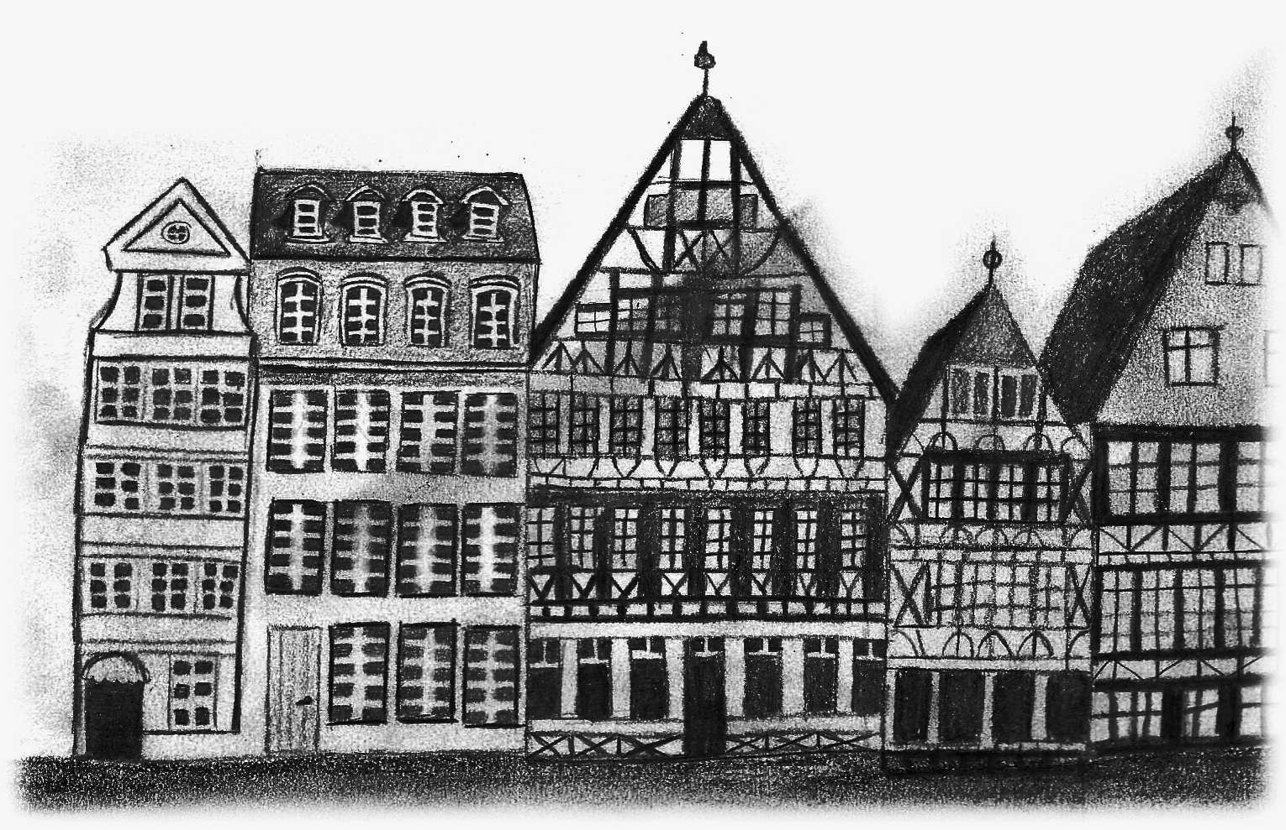
H - Sunlight
Overview
Given N columns in 2D
Find the proportion of angles above each column which aren’t occluded by other columns
For example:
2 1 3
y[0], 2× the height of y[1], occludes 45° of the view
y[3], 3× the height of y[1], occludes 63.4° of the view
N is quite large, so find a method more efficient than brute-force.
9 correct • solved at: 01:48 by
Beuler (University of Cambridge)
Author: Robin

Slide 21
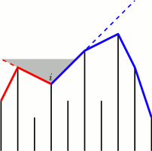
Sunlight - Solution
Techniques
Algorithm
Convex hull
Andrew’s algorithm
Trigonometry
Some first-pass observations:
When computing the angle for a building i, we can safely ignore all buildings not in the convex hull of buildings [0, i], and not in the convex hull of buildings [i, n-1].
In fact, the building defining the angle on right side of i comes directly after i in the convex hull of [i, n-1].
Similarly, the building defining the angle on the left side of i comes directly before i in the convex hull of [0, i].
Compute convex hull twice using Andrew’s algorithm
Maintain convex hulls on stack for [0, i] and for [i, n-1]
Left to right: Top of stack defines the left angle
Right to left: Top of stack defines the right angle

Slide 22

I - Nimionese
Overview
We have a string made of words, each composed of several syllables.
Three rules to apply:
First letter must be “hard” ie. member of a certain subset of consonants.
For the subsequent syllables all “hard” consonants must match the first letter
Each word must end in “ah”, “oh”, or “uh”.
69 correct • solved at: 00:33 by
Exception: teamName not found.
(University of Warwick)
Author: Max

Slide 23
Nimionese - Solution
Techniques
Algorithm
Regular expressions
String chopping
Read in each word separately
Use your language’s split() function to get an array of syllables
Three regexes:
let hard = “bcdgknpt” let soft = “aou” syll[ 0].sub(“^[^$hard]”, [x] ⟶ closest(x, hard)) syll[1...$].sub(“[$hard]”, [x] ⟶ syll[0][0]) syll[ $-1].sub(“[$hard]\$”, [x] ⟶ x + closest(x, soft) + ‘h’)
For the security-minded:
[...] .sub(“^[^$hard]”,,) [...]
Please don’t do this in real life!

Slide 24
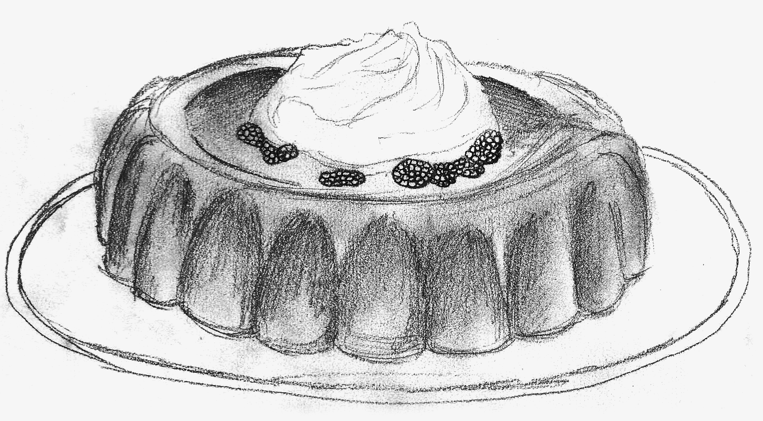
J - Jelly Raid
Overview
Given a 60x60 floor plan with walkable and blocked cells,
Locations of dormitory and kitchen,
And paths of 200 patrolling masters
(where every path contains at most 7 cells and masters follow it back and forth indefinitely)
Find the shortest path from the dormitory to the kitchen so that you are not seen by the patrolling masters
(where two people can see one another if they are in the same row or column and there are no blocked cells between them).
5 correct • solved at: 03:05 by
EE Dragons (University of Cambridge)
Author: Swen

Slide 25
Jelly Raid - Solution
Techniques
Algorithm
Least common multiple
Breadth first search
Sneakiness
Just running Dijkstra won’t work.
What if we get trapped somewhere?
Plugging time in as part of state makes for a slow solution
60 × 60 = 3600
O(N⁴)
The patrol periods for {1, 2, 3, 4, 5, 6, 7} will be {1, 2, 4, 6, 8, 10, 12}
LCM = 120
Let’s incorporate the current progress through the cycle into state
min_dist[120][rows][cols]
O(C × N²)

Slide 26
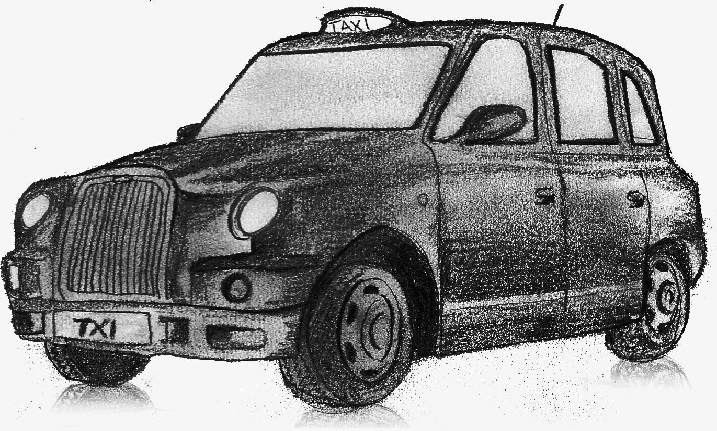
K - Call a Cab
Overview
Given:
N Points Of Interest
Restrictions on whether we can travel from POI i to j by taxi t
Minimal distance
Maximal variation in angle
Compute how to get from 0 to n in minimal number of hops using any kind of taxi.
0 correct
Author: Sander

Slide 27
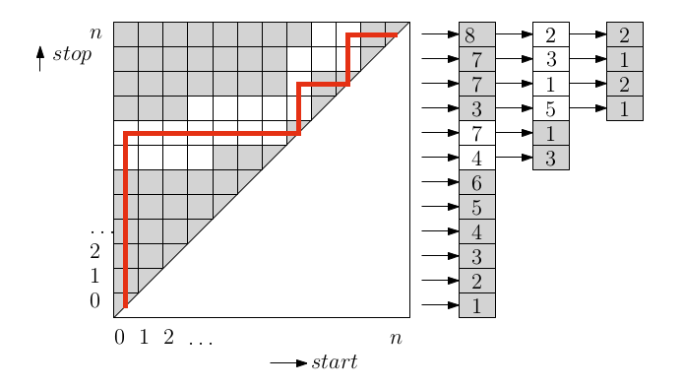
Call a Cab - Solution
Techniques
Algorithm
Two pointer algorithms
Multisets
Segment trees
Dynamic programming
For a given transportation type:
Farthest reachable POI is non-decreasing.
Nearest reachable POI is also non-decreasing.
Everything in between is accessible.
Execute two pointer algorithm for nearest and farthest. Moving a pointer takes O(1) and O(log(n)) time resp.
Minimum distance: keep a running total of distance travelled.
Maximum range: keep an auxiliary multiset of differences between all angles travelled, in sorted order. The heading range is given by 360.000 minus the largest angular difference.
Now we can run an efficient dynamic programming algorithm with a segment tree (or sliding window)

Slide 28
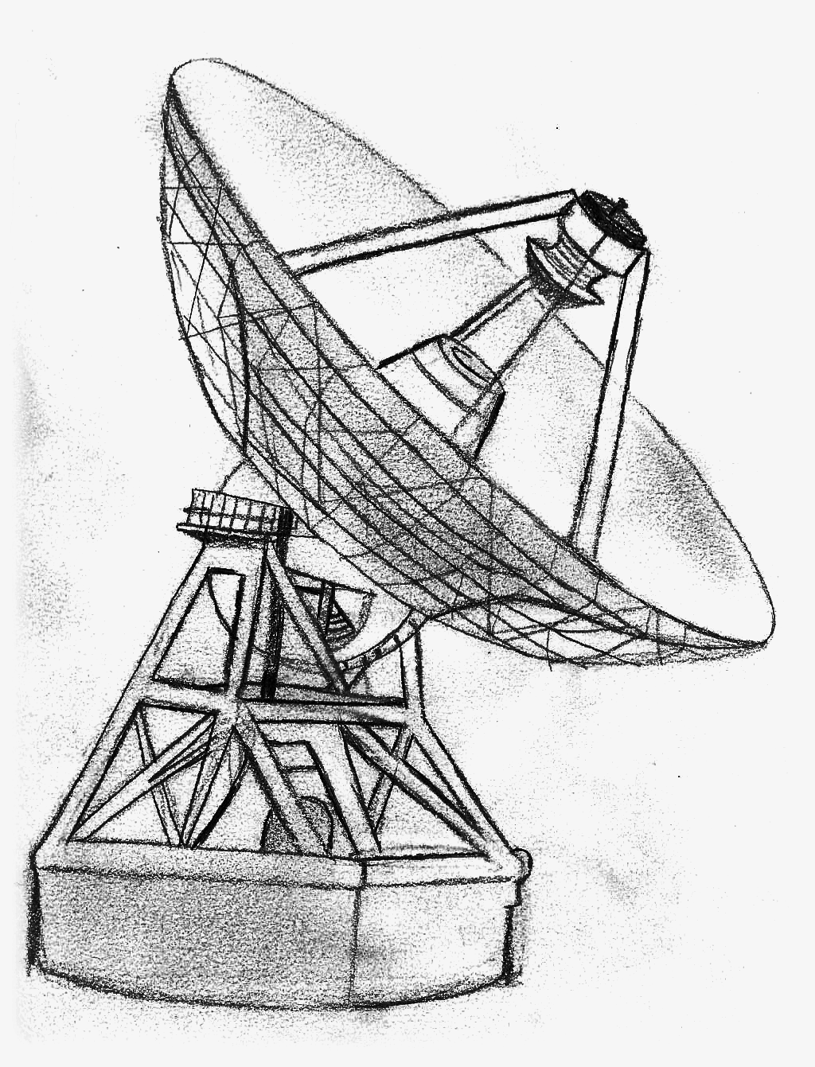
L - Telescope
Overview
A grid of boolean values has had a mean filter applied.
This means that where previously a value was cell[i][j]. it will become:
sum(cell[a][b]) ÷ n² for a,b where max(abs(a-i), abs(b-j)) < ½ n
We need to reverse this filter to count the number of connected components.
2 correct • solved at: 03:41 by
Me[N]tallica (University of Cambridge)
Author: Robin

Slide 29
Telescope - Solution
Techniques
Algorithm
Cumulative sums
Inclusion-exclusion
Flood fill
Multiply any blurred pixel by N² to get the number of white pixels in an NxN square around that pixel
0xFFFF / (100²) ≈ 6.5 so no precision has been lost
What if we subtract two squares?
pixels(a..b,c..d) - pixels(a-1..b-1,c..d) = pixels(b,c..d) - pixels(a-1,c..d)
How about four squares?
pixels(a..b,c..d) - pixels(a-1..b-1,c..d) - pixels(a..b,c-1..b-1) + pixels(a-1..b-1,c-1..d-1) = pixel(b,d) - pixel(a-1,d) - pixel(b,c-1) + pixel(a-1,c-1)
We know that all pixels outside the boundaries are completely black, so let’s work in from the edges restoring cells.
Complexity: O(RC)

Slide 30
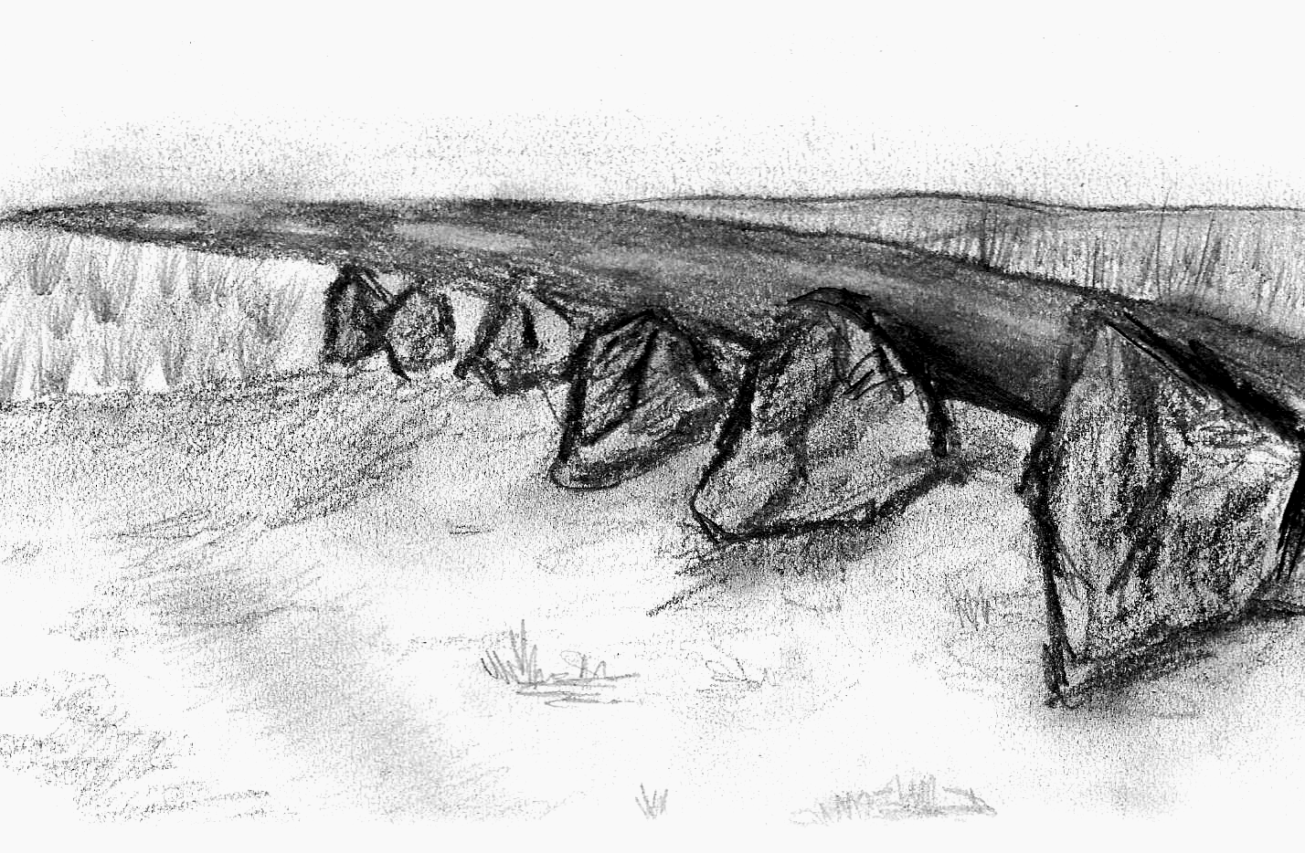
M - Milestones
Overview
Given
1 list A of observations of an event at one time scale factor
1 list B of when all events happened at another time scale factor
Find all of the scale factors that could plausibly be applied to B to get a substring that equals A.
Example:
1,2,3
3,4,5,7,9
3,4,5 = 1,2,3 × 1 + 2
5,7,9 = 1,2,3 × 2 + 1
30 correct • solved at: 00:57 by
DoCThors (Imperial College London)
Author: Robin

Slide 31
Milestone Counter - Solution
Techniques
Algorithm
String matching
Fractions
Let’s look at a base case: checking N times against N distances.
We can work out the speed from (d₁ - d₀) ÷ (t₁ - t₀)
Now we need to compare the speed for every pair: (d₁ - d₀) ÷ (t₁ - t₀) = (d_{x+1} - d_{x}) ÷ (t_{x+1} - t_{x}) or (t_{x+1} - t_{x}) ÷ (t_{x} - t_{x-1}) = (d_{x+1} - d_{x}) ÷ (d_{x} - d_{x-1})
What’s important is the ratio between current distance and previous distance.
The strings of M and N symbols are equivalent to strings of M-2 and N-2 fractions which should have exact matches.
From here it’s regular string comparison
Knuth Morris Pratt / Boyer Moore / Rabin Karp
Or since N is so small, brute force works too.

Slide 32

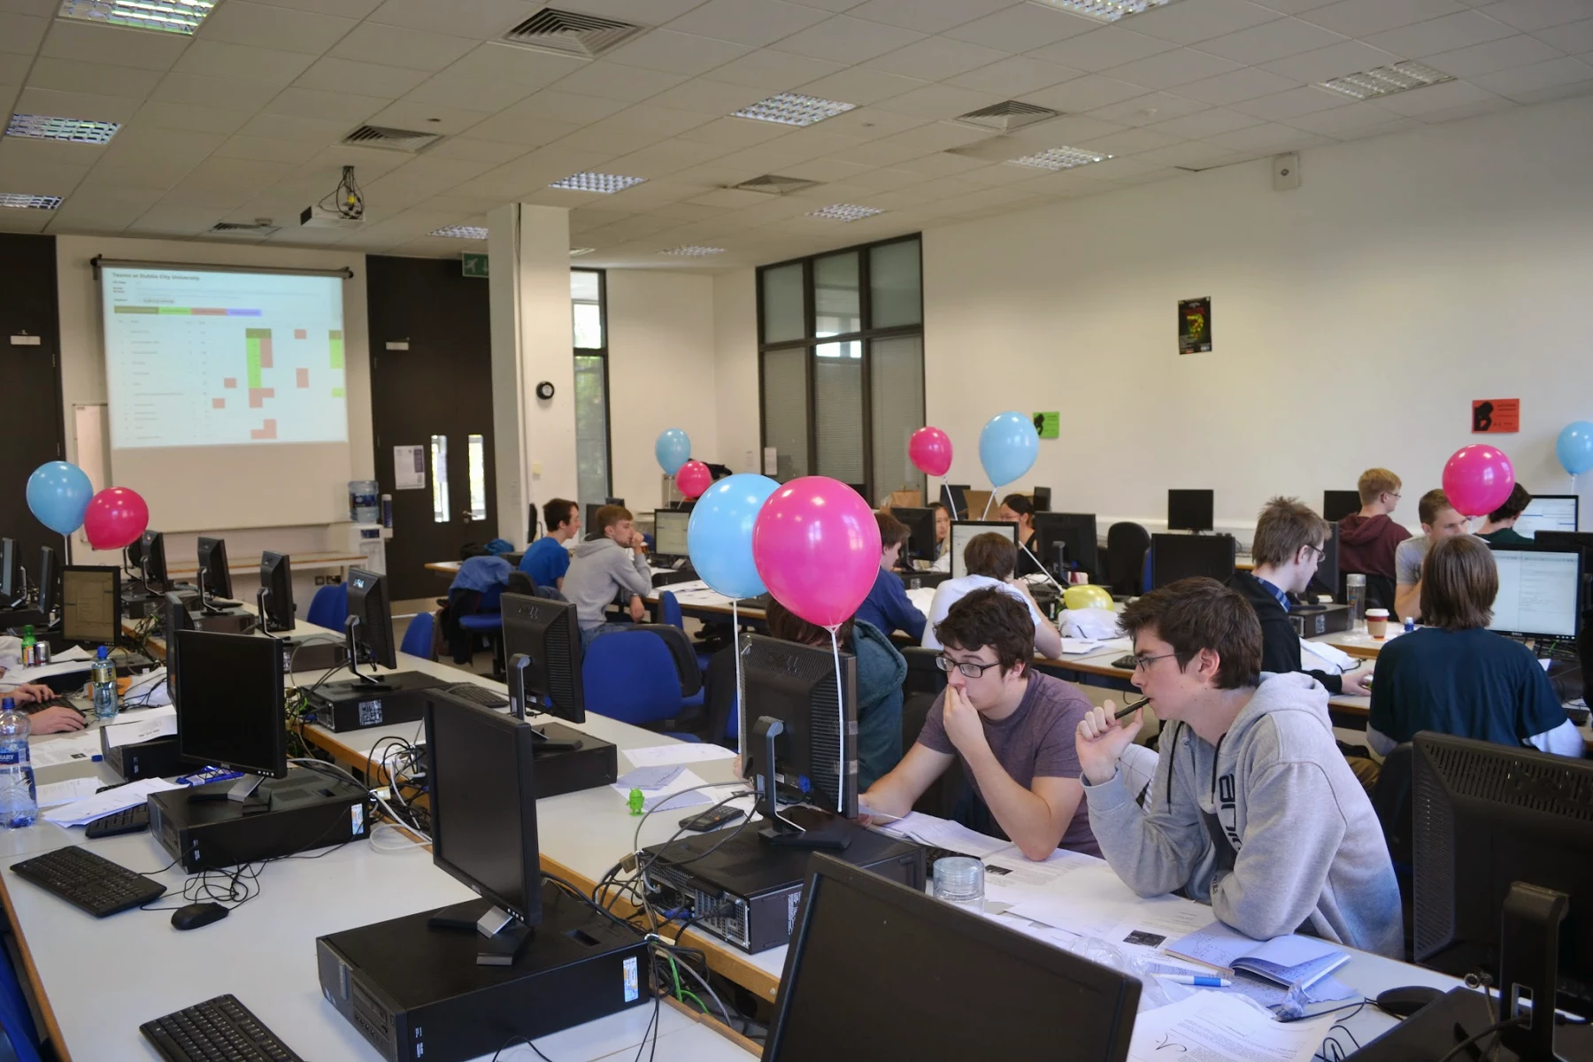


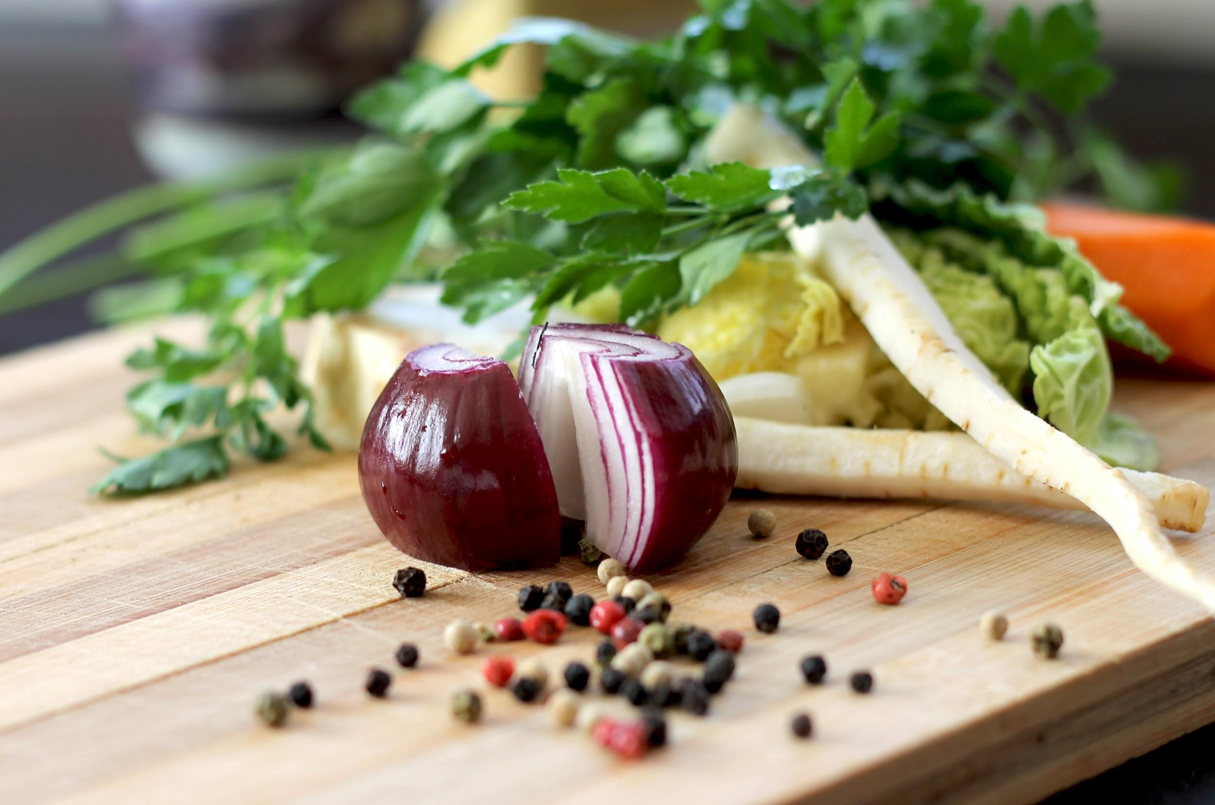




Slide 33
Questions?
Or comments?

Slide 34
Final Standings
http://ukiepc-2015.bath.ac.uk/

